Slide 1
Assessment of FGO

Slide 2
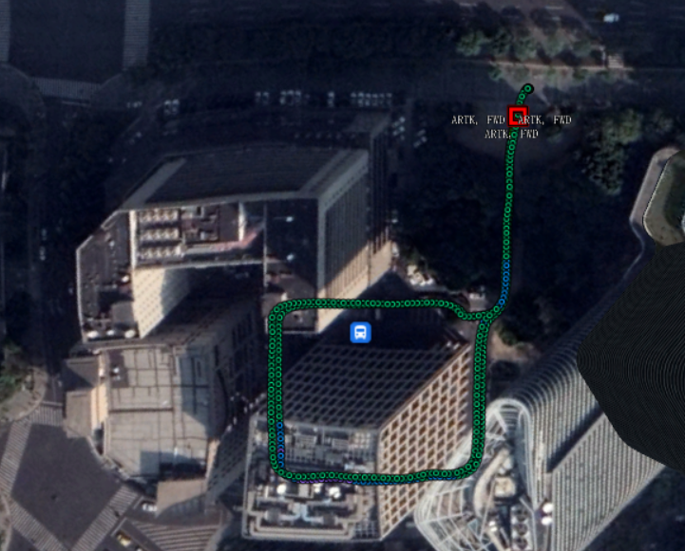
0113 ZLL Data
Time:2022/01/13 10:15:15-10:32:14

Slide 3
LJJLD Data
Time:2022/01/20 LJJLD 08:44:13-09:09:11

Slide 4

0113 ZLL Data
Time:2022/01/13 10:15:15-10:32:14

Slide 5
0113 ZLL Data
Time:2022/01/13 10:15:15-10:32:14
 | RMS | MEAN | STD | MAX | MIN | CEP
WLS | 35.516 | 29.782 | 19.376 | 84.908 | 0.39163 | 52.131
3DMA | 19.569 | 17.081 | 9.5543 | 39.052 | 0.49282 | 31.998
FGO | 28.658 | 20.801 | 19.738 | 91.453 | 0.57899 | 41.55
FGO-3DMA | 13.92 | 11.786 | 7.4112 | 36.177 | 0.18138 | 23.698
Imp-3DMA | 44.90% | 42.65% | 50.69% | 54.01% | -25.84% | 38.62%
Imp-FGO | 19.31% | 30.16% | -1.87% | -7.71% | -47.84% | 20.30%
Imp-FGO-3DMA | 60.81% | 60.43% | 61.75% | 57.39% | 53.69% | 54.54%

Slide 6
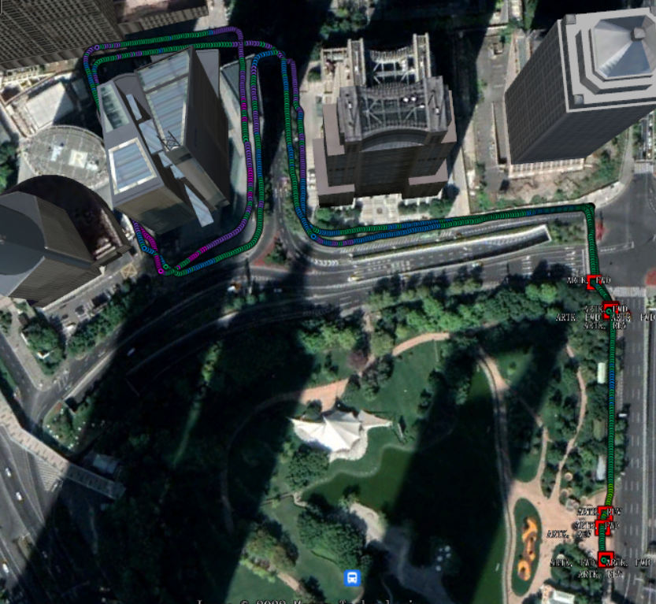
LJJLD Data
Time:2022/01/20 LJJLD 08:44:13-09:09:11

Slide 7
LJJLD Data
Time:2022/01/20 LJJLD 08:44:13-09:09:11

Slide 8

LJJLD Data
Time:2022/01/20 LJJLD 08:44:13-09:09:11

Slide 9
LJJLD Data
Time:2022/01/20 LJJLD 08:44:13-09:09:11
 | RMS | MEAN | STD | MAX | MIN | CEP
WLS | 90.781 | 73.012 | 53.993 | 275.45 | 1.6987 | 155.45
3DMA | 20.706 | 18.381 | 9.5344 | 39.984 | 1.0588 | 35.323
FGO | 50.104 | 39.406 | 30.968 | 182.3 | 2.5469 | 85.706
FGO-3DMA | 16.303 | 14.191 | 8.0277 | 37.98 | 0.21004 | 27.853
Imp-3DMA | 77.19% | 74.82% | 82.34% | 85.48% | 37.67% | 77.28%
Imp-FGO | 44.81% | 46.03% | 42.65% | 33.82% | -49.93% | 44.86%
Imp-FGO-3DMA | 82.04% | 80.56% | 85.13% | 86.21% | 87.64% | 82.08%

Slide 10
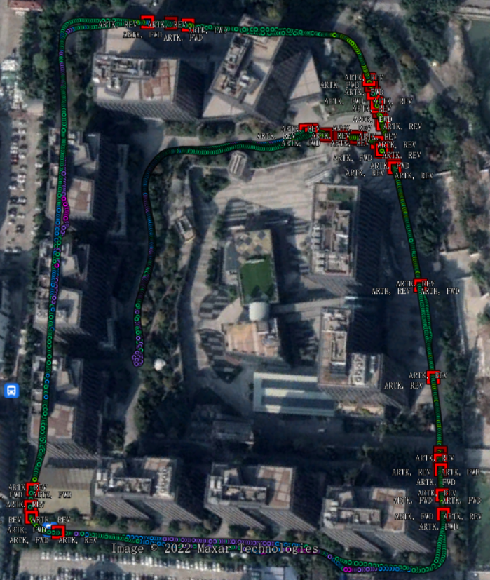
WG Data
Time:2022/01/20 LJJLD 05:32:58-06:17:13

Slide 11
WG Data
Time:2022/01/20 LJJLD 05:32:58-06:17:13

Slide 12

WG Data
Time:2022/01/20 LJJLD 05:32:58-06:17:13

Slide 13
WG Data
Time:2022/01/20 LJJLD 05:32:58-06:17:13
 | RMS | MEAN | STD | MAX | MIN | CEP
WLS | 31.066 | 26.937 | 15.53 | 77.516 | 3.3161 | 50.926
3DMA | 12.969 | 11.163 | 6.6112 | 34.97 | 0.42633 | 17.458
FGO | 16.383 | 14.221 | 8.1557 | 37.5 | 2.1261 | 27.049
FGO-3DMA | 8.7654 | 7.4832 | 4.5704 | 28.512 | 0.093281 | 13.697
Imp-3DMA | 58.25% | 58.56% | 57.43% | 54.89% | 87.14% | 65.72%
Imp-FGO | 47.27% | 47.21% | 47.48% | 51.62% | 35.88% | 46.89%
Imp-FGO-3DMA | 71.79% | 72.22% | 70.57% | 63.22% | 97.19% | 73.11%

Slide 14
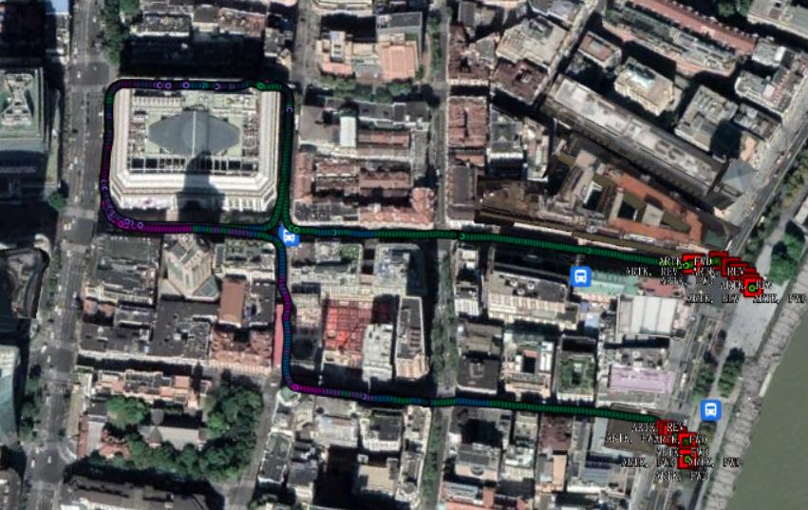
NJDL Data
Time:2022/01/25 LJJLD 06:51:36-07:18:44

Slide 15
NJDL Data
Time:2022/01/25 LJJLD 06:51:36-07:18:44

Slide 16
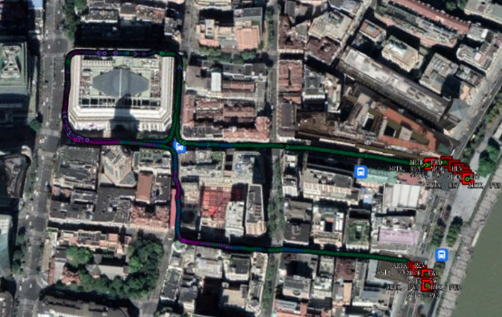
NJDL Data
Time:2022/01/25 LJJLD 06:51:36-07:18:44

Slide 17
NJDL Data
Time:2022/01/25 LJJLD 06:51:36-07:18:44
 | RMS | MEAN | STD | MAX | MIN | CEP
WLS | 21.267 | 17.36 | 12.295 | 56.731 | 0.58979 | 35.436
3DMA | 17.181 | 14.867 | 8.6153 | 38.65 | 0.36202 | 28.122
FGO | 18.391 | 14.088 | 11.831 | 56.888 | 0.4068 | 31.545
FGO-3DMA | 11.495 | 9.6685 | 6.2185 | 29.894 | 0.22791 | 18.574
Imp-3DMA | 19.21% | 14.36% | 29.93% | 31.87% | 38.62% | 20.64%
Imp-FGO | 13.52% | 18.85% | 3.77% | -0.28% | 31.03% | 10.98%
Imp-FGO-3DMA | 45.95% | 44.31% | 49.42% | 47.31% | 61.36% | 47.59%

Slide 18
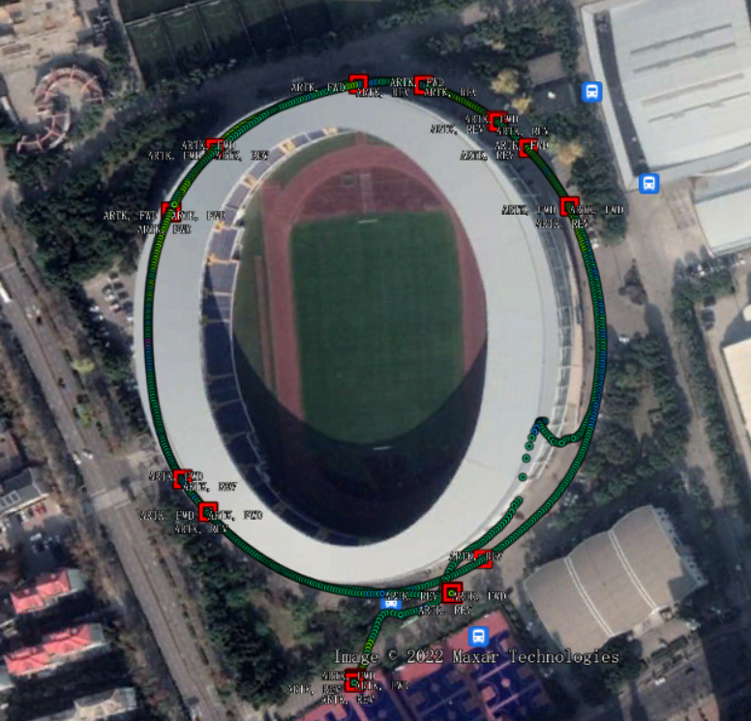
YSTYG Data
Time:2022/01/25 03:13:30-03:33:47

Slide 19
YSTYG Data
Time:2022/01/25 03:13:30-03:33:47

Slide 20

YSTYG Data
Time:2022/01/25 03:13:30-03:33:47

Slide 21
YSTYG Data
Time:2022/01/25 03:13:30-03:33:47
 | RMS | MEAN | STD | MAX | MIN | CEP
WLS | 32.681 | 27.834 | 17.142 | 124.31 | 3.5289 | 54.601
3DMA | 18.374 | 15.544 | 9.8012 | 39.826 | 0.62576 | 30.308
FGO | 20.756 | 16.573 | 12.507 | 81.152 | 0.30295 | 31.903
FGO-3DMA | 13.086 | 11.109 | 6.9192 | 34.023 | 0.18123 | 20.612
Imp-3DMA | 43.78% | 44.16% | 42.82% | 67.96% | 82.27% | 44.49%
Imp-FGO | 36.49% | 40.46% | 27.04% | 34.72% | 91.42% | 41.57%
Imp-FGO-3DMA | 59.96% | 60.09% | 59.64% | 72.63% | 94.86% | 62.25%

Slide 22
HUAWEI WATCH DATA

Slide 23
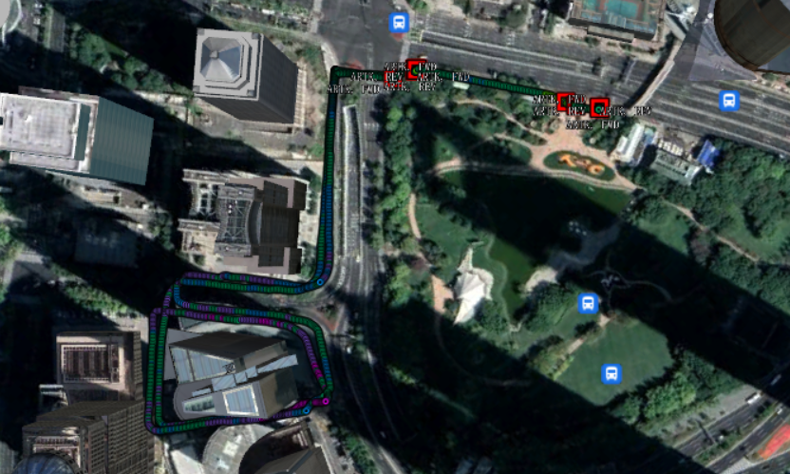
LJJLD Data
Time:2022/01/20 08:44:49-09:07:58

Slide 24
LJJLD Data
Time:2022/01/20 08:44:49-09:07:58

Slide 25
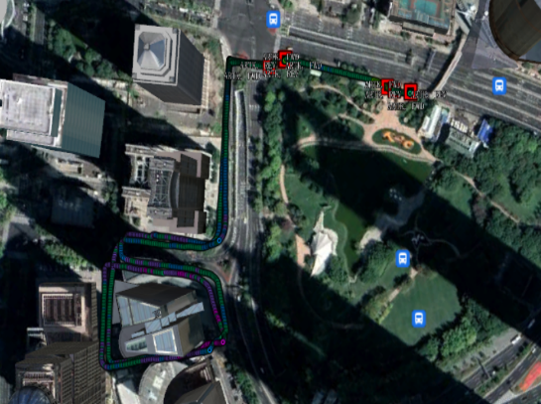
LJJLD Data
Time:2022/01/20 08:44:49-09:07:58

Slide 26
LJJLD Data
Time:2022/01/20 08:44:49-09:07:58
 | RMS | MEAN | STD | MAX | MIN | CEP
WLS | 96.804 | 76.853 | 58.916 | 284.2 | 0.7789 | 167.26
3DMA | 22.403 | 20.177 | 9.7398 | 39.458 | 0.64469 | 37.958
FGO | 49.675 | 35.548 | 34.721 | 163.15 | 0.89807 | 84.038
FGO-3DMA | 18.576 | 16.724 | 8.0893 | 62.36 | 1.235 | 31.389
Imp-3DMA | 76.86% | 73.75% | 83.47% | 86.12% | 17.23% | 77.31%
Imp-FGO | 48.69% | 53.75% | 41.07% | 42.59% | -15.30% | 49.76%
Imp-FGO-3DMA | 80.81% | 78.24% | 86.27% | 78.06% | -58.56% | 81.23%

Slide 27
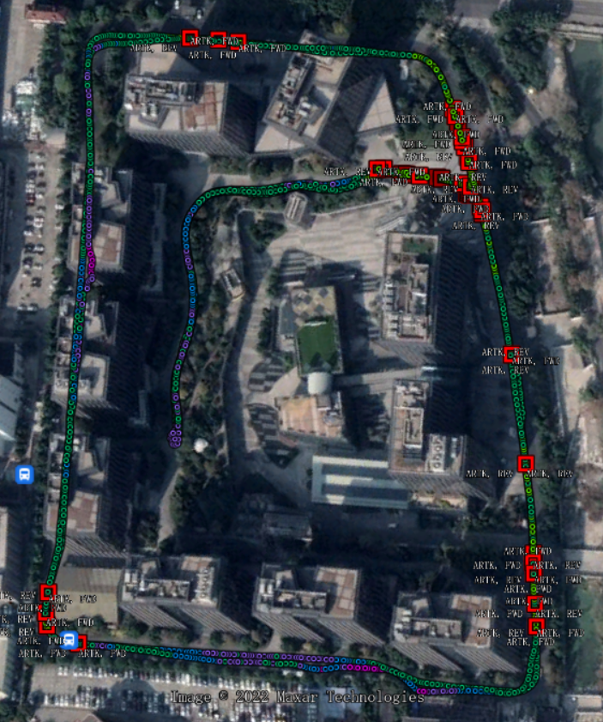
WG Data
Time:2022/01/20 05:32:17-06:16:22

Slide 28
WG Data
Time:2022/01/20 05:32:17-06:16:22

Slide 29
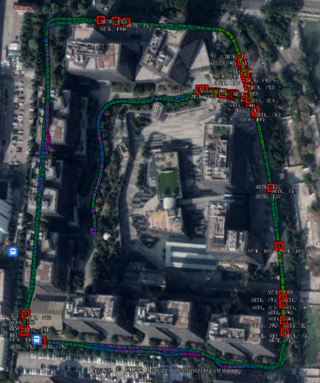
WG Data
Time:2022/01/20 05:32:17-06:16:22

Slide 30
WG Data
Time:2022/01/20 05:32:17-06:16:22
 | RMS | MEAN | STD | MAX | MIN | CEP
WLS | 20.222 | 16.357 | 11.893 | 82.602 | 0.50096 | 32.157
3DMA | 22.842 | 20.792 | 9.4583 | 39.643 | 1.4082 | 38.45
FGO | 14.676 | 11.907 | 8.5827 | 103.26 | 0.42624 | 22.397
FGO-3DMA | 16.81 | 14.988 | 7.6124 | 103.49 | 0.30903 | 28.774
Imp-3DMA | -12.96% | -27.11% | 20.47% | 52.01% | -181.10% | -19.57%
Imp-FGO | 27.42% | 27.21% | 27.84% | -25.01% | 14.91% | 30.35%
Imp-FGO-3DMA | 16.87% | 8.37% | 35.99% | -25.28% | 38.31% | 10.52%

Slide 31
NJDL Data
Time:2022/01/25 06:53:56-07:16:20

Slide 32
NJDL Data
Time:2022/01/25 06:53:56-07:16:20

Slide 33

NJDL Data
Time:2022/01/25 06:53:56-07:16:20

Slide 34
NJDL Data
Time:2022/01/25 06:53:56-07:16:20
 | RMS | MEAN | STD | MAX | MIN | CEP
WLS | 25.717 | 19.562 | 16.703 | 138.2 | 0.21515 | 41.881
3DMA | 26.88 | 24.827 | 10.306 | 39.843 | 2.4347 | 45.349
FGO | 27.04 | 20.127 | 18.066 | 178.8 | 0.40381 | 44.934
FGO-3DMA | 25.907 | 20.537 | 15.799 | 180.31 | 0.81435 | 43.846
Imp-3DMA | -4.52% | -26.91% | 38.29% | 71.17% | -1031.60% | -8.28%
Imp-FGO | -5.14% | -2.89% | -8.16% | -29.38% | -87.69% | -7.29%
Imp-FGO-3DMA | -0.74% | -4.98% | 5.41% | -30.47% | -278.51% | -4.69%
Doppler measurements:
Smart Phone -0.30108 2.4499 -0.56216
Wearable 7.413841 -79.7235 -38.7236

Slide 35
YSTYG Data
Time:2022/01/25 03:14:04-03:32:56

Slide 36
YSTYG Data
Time:2022/01/25 03:14:04-03:32:56

Slide 37

YSTYG Data
Time:2022/01/25 03:14:04-03:32:56

Slide 38
YSTYG Data
Time:2022/01/25 03:14:04-03:32:56
 | RMS | MEAN | STD | MAX | MIN | CEP
WLS | 35.726 | 18.954 | 30.303 | 274.82 | 0.09924 | 60.059
3DMA | 20.909 | 18.35 | 10.028 | 39.674 | 0.71241 | 33.827
FGO | 16.153 | 13.191 | 9.3273 | 119.64 | 0.36007 | 27.262
FGO-3DMA | 18.611 | 15.942 | 9.6078 | 105.27 | 0.8529 | 29.326
Imp-3DMA | 41.47% | 3.18% | 66.91% | 85.56% | -617.86% | 43.68%
Imp-FGO | 54.79% | 30.41% | 69.22% | 56.47% | -262.83% | 54.61%
Imp-FGO-3DMA | 47.91% | 15.89% | 68.29% | 61.69% | -759.43% | 51.17%

Slide 39
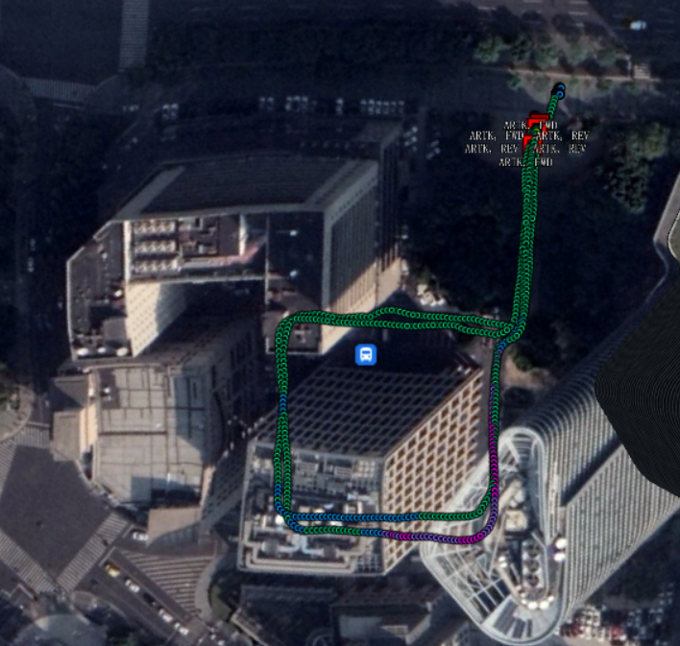
ZLL Data
Time:2022/01/25 04:02:48-04:17:52

Slide 40
ZLL Data
Time:2022/01/25 04:02:48-04:17:52

Slide 41

ZLL Data
Time:2022/01/25 04:02:48-04:17:52

Slide 42
ZLL Data
Time:2022/01/25 04:02:48-04:17:52
 | RMS | MEAN | STD | MAX | MIN | CEP
WLS | 58.87 | 42.807 | 40.49 | 299.1 | 0.87261 | 100.8
3DMA | 20.142 | 18.138 | 8.7623 | 38.972 | 0.43524 | 31.796
FGO | 41.857 | 34.546 | 23.648 | 252.48 | 1.3364 | 70.025
FGO-3DMA | 23.035 | 15.291 | 17.238 | 250.87 | 1.6089 | 37.92
Imp-3DMA | 65.79% | 57.63% | 78.36% | 86.97% | 50.12% | 68.46%
Imp-FGO | 28.90% | 19.30% | 41.60% | 15.59% | -53.15% | 30.53%
Imp-FGO-3DMA | 60.87% | 64.28% | 57.43% | 16.13% | -84.38% | 62.38%

Slide 43
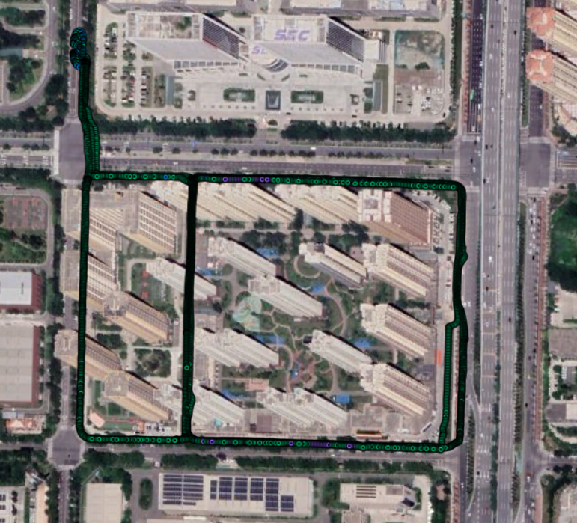
Xi’an MTY Outer
Time:2021/12/06 07:45:44-08:11:45

Slide 44
Xi’an MTY Outer
Time:2021/12/06 07:45:44-08:11:45

Slide 45

Xi’an MTY Outer
Time:2021/12/06 07:45:44-08:11:45

Slide 46
Xi’an MTY Outer
Time:2021/12/06 07:45:44-08:11:45
 | RMS | MEAN | STD | MAX | MIN | CEP
WLS | 33.008 | 21.036 | 25.448 | 116.79 | 0.27905 | 53.159
3DMA | 23.899 | 21.275 | 10.891 | 39.549 | 0.32614 | 39.281
FGO | 10.89 | 9.3564 | 5.5743 | 35.877 | 0.21248 | 16.976
FGO-3DMA | 22.955 | 20.876 | 9.5477 | 41.536 | 1.194 | 39.257
Imp-3DMA | 27.60% | -1.14% | 57.20% | 66.14% | -16.88% | 26.11%
Imp-FGO | 67.01% | 55.52% | 78.10% | 69.28% | 23.86% | 68.07%
Imp-FGO-3DMA | 30.46% | 0.76% | 62.48% | 64.43% | -327.88% | 26.15%

Slide 47
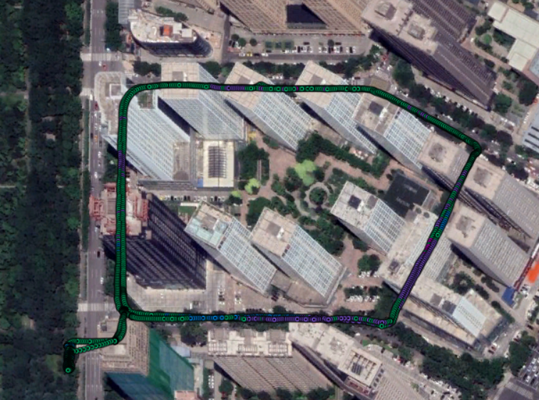
Xi’an WZ
Time:2021/12/07 04:24:06-04:45:37

Slide 48
Xi’an WZ
Time:2021/12/07 04:24:06-04:45:37

Slide 49

Xi’an WZ
Time:2021/12/07 04:24:06-04:45:37

Slide 50
Xi’an WZ
Time:2021/12/07 04:24:06-04:45:37
 | RMS | MEAN | STD | MAX | MIN | CEP
WLS | 28.838 | 21.038 | 19.734 | 139.72 | 0.544 | 48.454
3DMA | 23.408 | 20.495 | 11.315 | 39.069 | 0.6768 | 36.699
FGO | 27.834 | 17.595 | 21.577 | 276.29 | 1.042 | 47.371
FGO-3DMA | 28.182 | 19.523 | 20.332 | 282.05 | 0.86785 | 47.83
Imp-3DMA | 18.83% | 2.58% | 42.66% | 72.04% | -24.41% | 24.26%
Imp-FGO | 3.48% | 16.36% | -9.34% | -97.75% | -91.55% | 2.24%
Imp-FGO-3DMA | 2.28% | 7.20% | -3.03% | -101.88% | -59.53% | 1.29%
Doppler Measurements
-82.6415 -93.5185 -90.7779

Slide 51
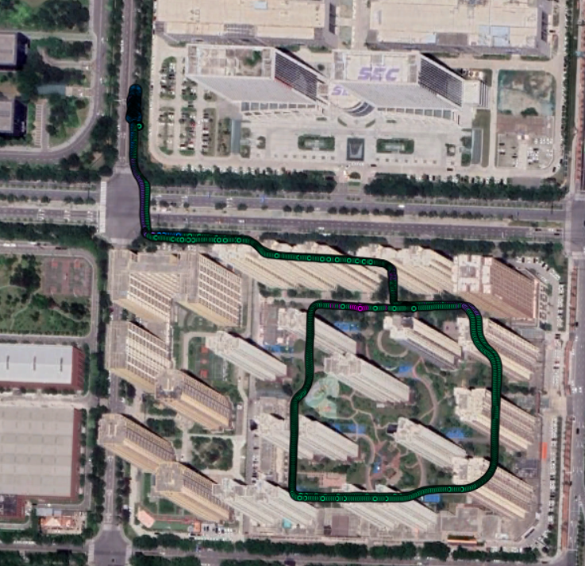
Xi’an MTY Small
Time:2021/12/08 02:48:47-03:03:19

Slide 52
Xi’an MTY Small
Time:2021/12/08 02:48:47-03:03:19

Slide 53

Xi’an MTY Small
Time:2021/12/08 02:48:47-03:03:19

Slide 54
Xi’an MTY Small
Time:2021/12/08 02:48:47-03:03:19
 | RMS | MEAN | STD | MAX | MIN | CEP
WLS | 62.436 | 45.37 | 42.926 | 296.22 | 1.1896 | 107.44
3DMA | 30.078 | 28.901 | 8.3367 | 39.969 | 1.028 | 42.033
FGO | 27.586 | 23.404 | 14.613 | 83.771 | 1.1345 | 46.803
FGO-3DMA | 29.142 | 27.7 | 9.061 | 81.852 | 5.1312 | 43.627
Imp-3DMA | 51.83% | 36.30% | 80.58% | 86.51% | 13.59% | 60.88%
Imp-FGO | 55.82% | 48.42% | 65.96% | 71.72% | 4.63% | 56.44%
Imp-FGO-3DMA | 53.33% | 38.95% | 78.89% | 72.37% | -331.33% | 59.40%

